Slide 1
AGRICULTURE AND AQUACULTURE SYSTEM

Slide 2
Student at KL University
SDP 2 Stands for Skill Development Project 3.
OUR TEAM MEMBERS :
2000090019 – khilji Abu Sufiyan Hussain
2000090057 – Kolli Charan
3. 2000090045 – chithirala harsha vardhan
Now getting into the concepts
About this Article.
About our project.
Photos During the Survey.
Charts And Graphs On Surveys That We Have Conducted.

Slide 3

Now getting into the concepts :-
1.About this Article.
2. About our project.
3. Photos During the Survey.
4. Charts And Graphs On Surveys That We Have Conducted.
5. Interviews
6. Understanding the Problems
7.The customer Journey Map
8. User Persona.
9. Flow chart.
10. Empathy Map.
11. User stories
12. Conclusion

Slide 4
PHOTOS DURING SURVEY :

Slide 5
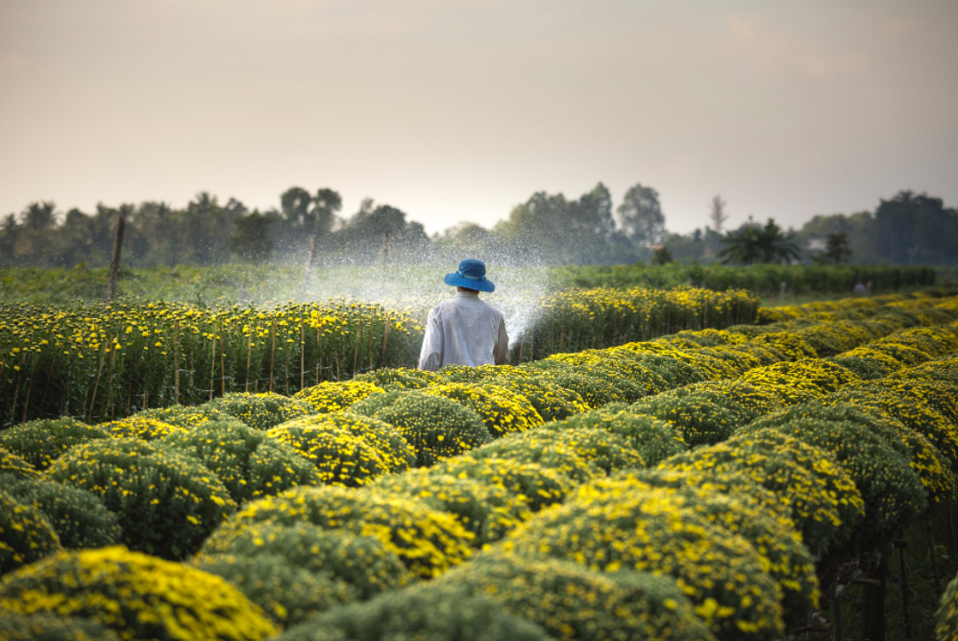
B

Slide 6
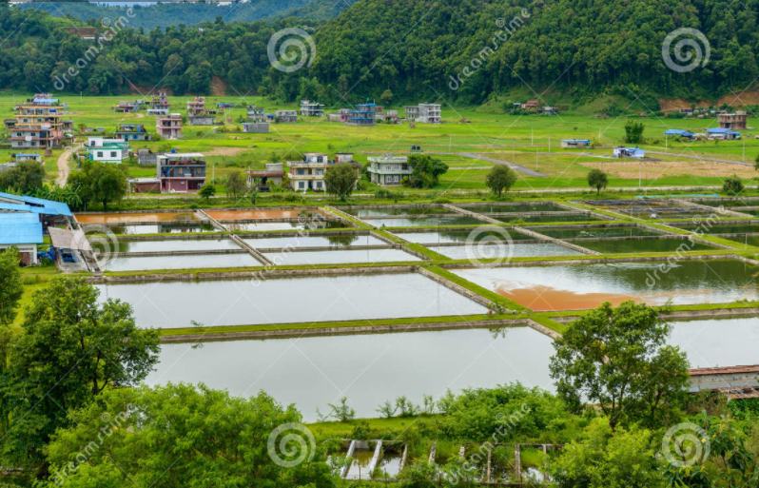

Slide 7
Live survey:
during the live survey we have discusssed about many farmers and we known about there problems.
in the survey we have got known about the cultures and the process of both agri and aquacultures.
our team have discussed about the problems of the FARMERS and how can we help them and is the present TECHNOLOGY is useful for them or not.
Due to the LIVE SURVEY we got to many things about the CULTURE and the BEHAVIOUR of the FARMER and the OTHER things which are beyond our expectations.

Slide 8
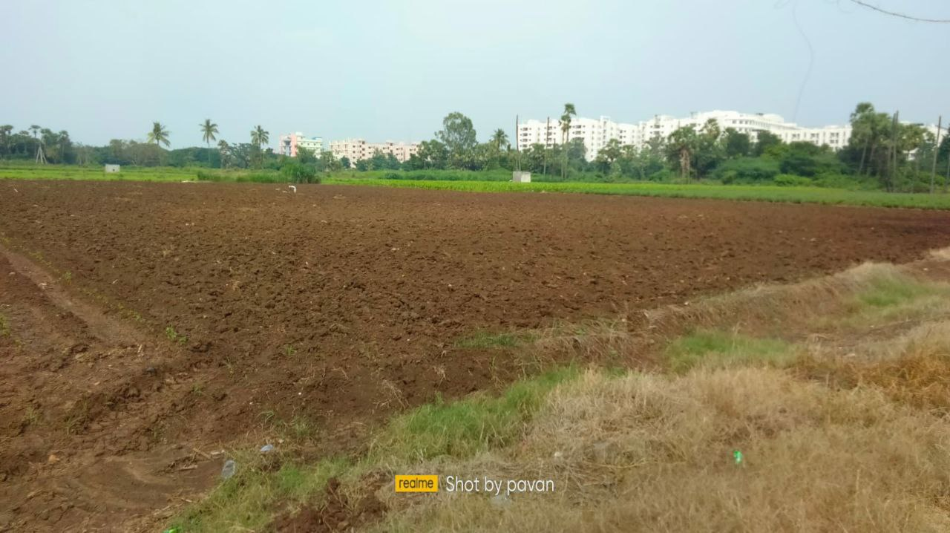

Slide 9
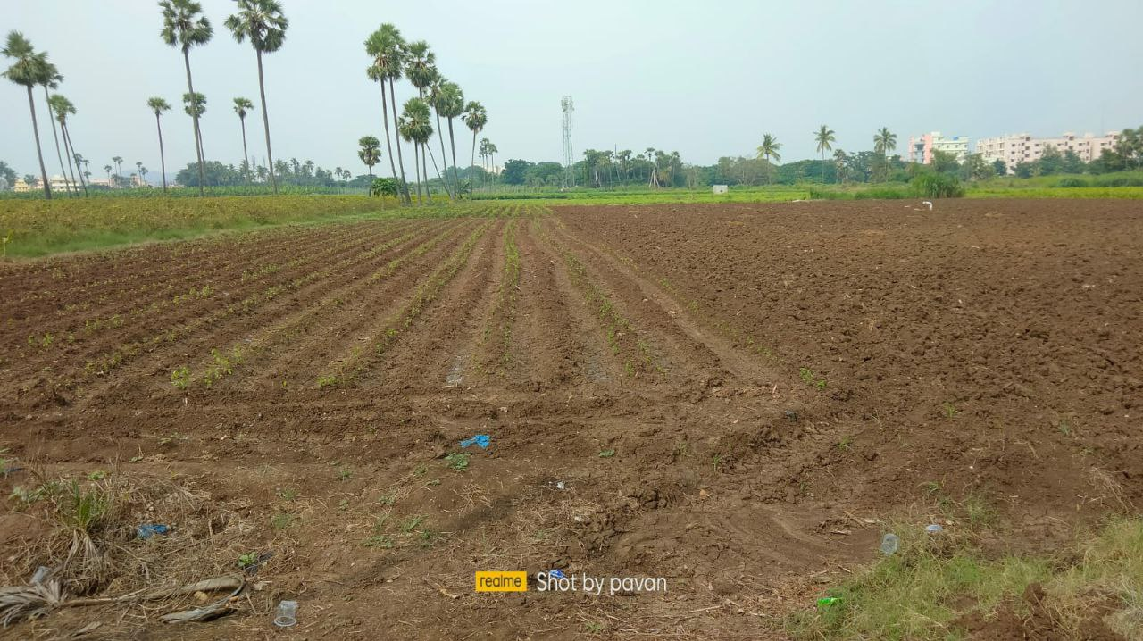

Slide 10
LOCATION:
GREEN Fields, near KL UNIVERSITY, Vaddeswaram, Vijayawada, Krishna – 522502, Andhra pradhesh.

Slide 11
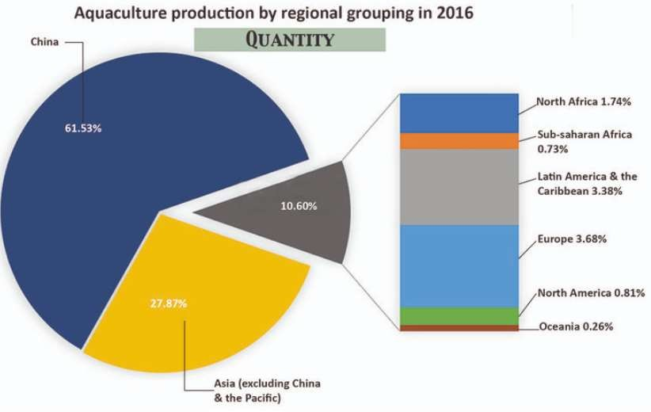
Charts And Graphs On Surveys :

Slide 12
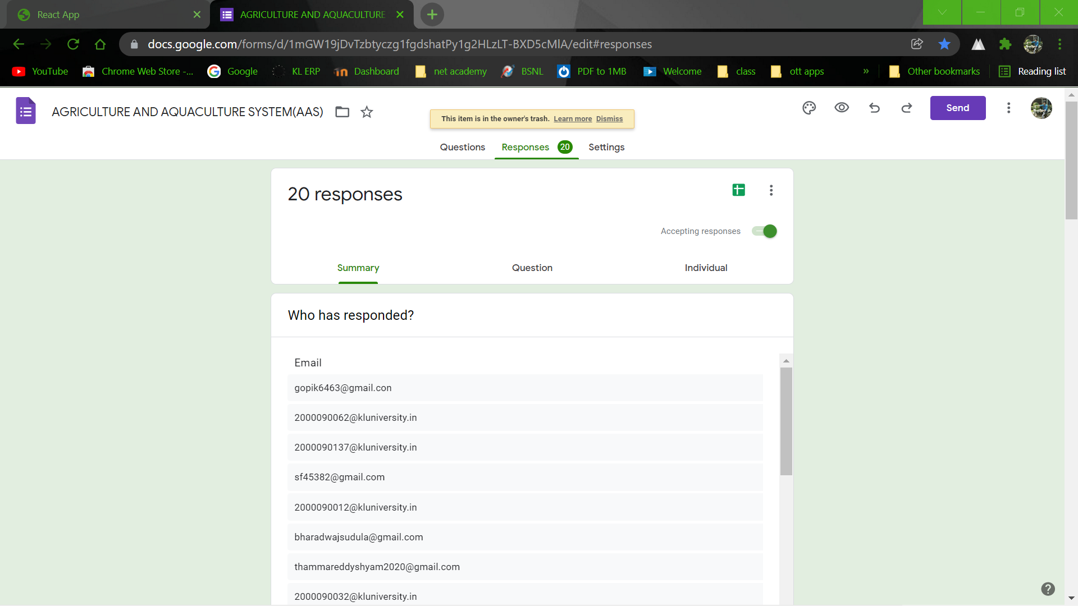
Form Floated :

Slide 13
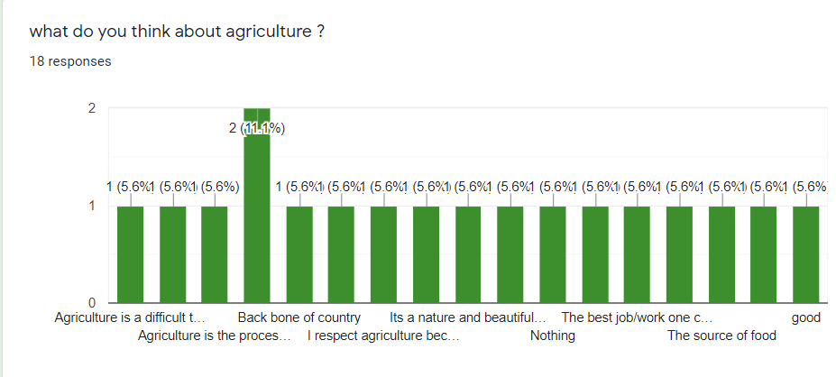
Peoples opinion:

Slide 14
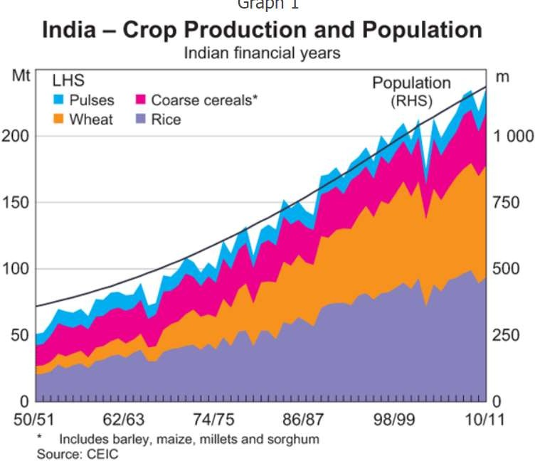

Slide 15

INTERVIEWS:

Slide 16
We have questioned many of the FARMERS and have discussed about the CULTURE of there particular work and there work .
The way they have answered us about the way they are working and we have learnt many things also got a idea about developing that may help them to take on and we can proceed.
We have developed in a way that it can help many of the FARMERS and can proceed as it is developed in a way that cane be more useful.

Slide 17
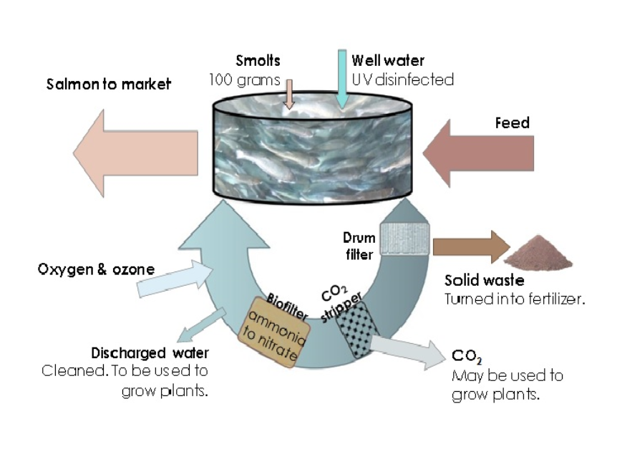

Slide 18
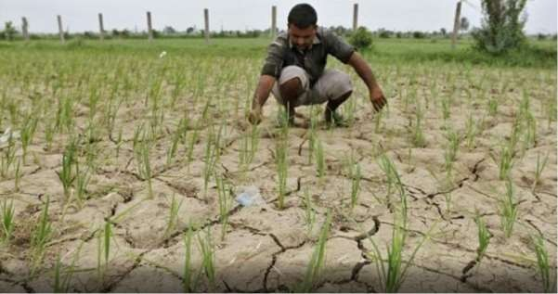

Slide 19
The customer Journey Map :
THE IMPORTANT POINTS IN CUSTOMER JOURNEY MAP
*AWARENESS
*SEARCH
*CONSIDER
*PURCHASE
*LOYALITY
*ADOVACY

Slide 20
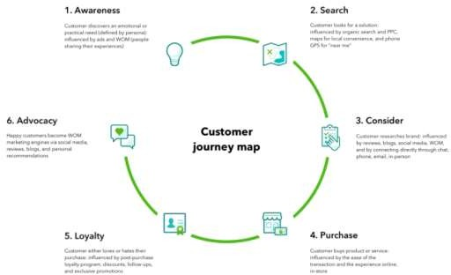
The customer Journey Map :

Slide 21
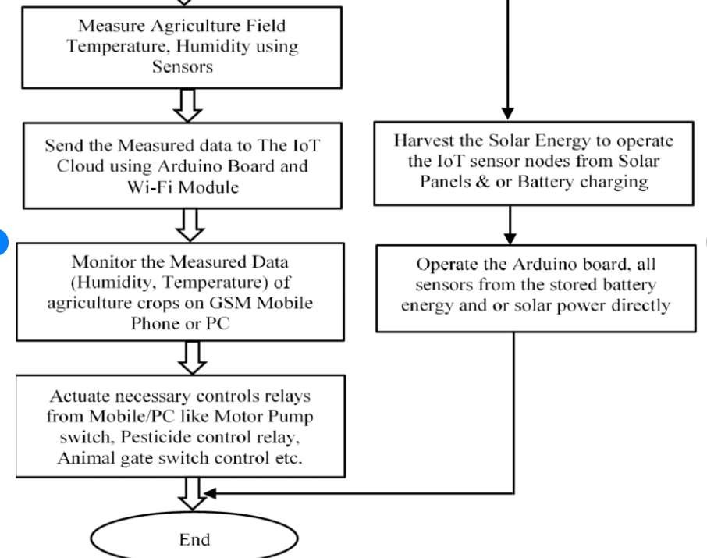
Flow Chart :
:

Slide 22
Empathy Map :-
User stories :
1
As a user I should be able to fetch my required things with ease.
2
2. As a user I should be able to use the APP without
3
Inconvenience
3. As a Manager, I should make sure of proper working of APP provided for customers
4
and be able to update the availability of services in business systems
4. As a user I should be able to select items to max extent
5
if necessary and proper security must be given at the time of payment.

Slide 23
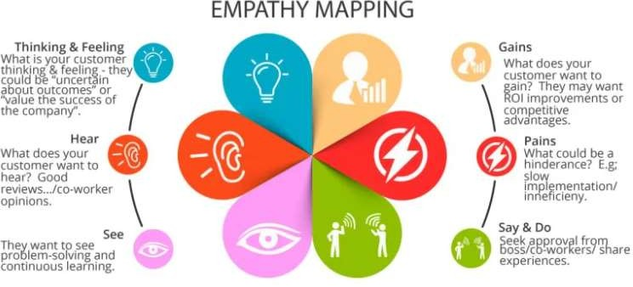
Empathy Map :-

Slide 24
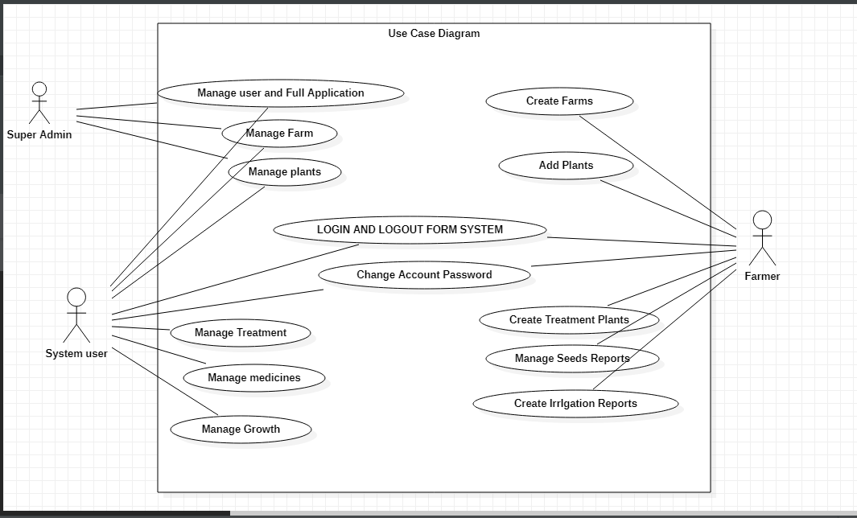

Slide 25
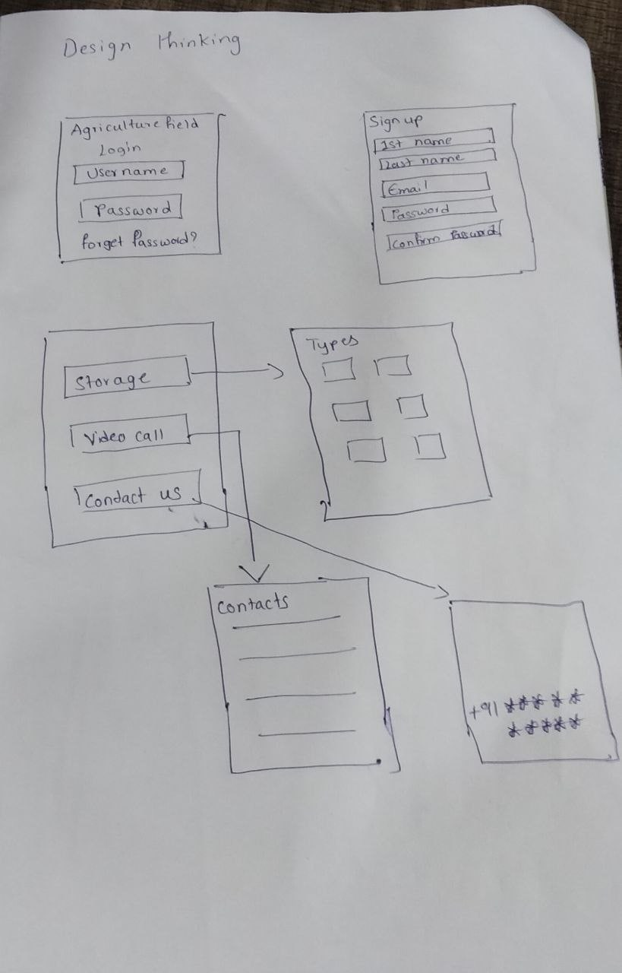
Design thinking:-

Slide 26
Conclusion :
We are looking forward to make this Project User friendly.
By observing these insights we got some clarity about how to make this Business System possible.

Slide 27
QUOTE:
OUR FARMER OUR RESPECT

Slide 28


Slide 29


